Slide 1


What if we could detect depression just by listening to someone’s voice?

Slide 2




Enhancing Depression Severity Prediction Through Speech Prosody using Contrastive Deep Learning
TEAM
Sakinah Hilya
UST
Khairul Makirin
KAIST
Rafsan Jany
UST
2025 Future Scholars’ Creative & Interdisciplinary Research Idea Challenge

Slide 3

01
Study background

Slide 4
According to WHO, approximately 332 million people worldwide suffers from depression.
It is the most common mental health issue of the 21st century
Affects young adults and elderlies
Leading cause of suicide among 15 - 29 years old

Slide 5
Early detection of depression is very crucial
Early screening of depression is very crucial to assess the severity of the illness in order to treat it accordingly.
Standardised test for depression such as PHQ-8 and HAM-D defines 5 levels of depression:
Minimal
Mild
Moderate
Moderately severe
Severe

Slide 6
Speech as a Biomarker
Early psychiatrists in the 19th, such as Emil Kraepelin and Eugen Bleuler, have noted common prosodic characteristics like low pitch and slow speech occurred in patients with schizophrenia and dementia praecox.
Many research have gone into detecting depression using biomarkers such as vocal prosody, language utilization, and visual cues
Speech as a promising biomarker has been studied through the use of machine learning models (Koops, et. al, 2023)

Slide 7

02
Research Objective

Slide 8
Objective and Contributions
The objective of this research is to improve the accuracy of predicting depression severity through speech processing by utilizing a deep learning model trained using supervised contrastive learning. Since most research in depression detection based on voice prosody uses data obtained privately in clinical interviews, this research also aims to build a standardized dataset of audio features for depression using multiple open-source datasets.
Contributions:
A novel deep learning model trained using supervised contrastive learning for classifying the severity of depression through speech as input
An open standardized dataset of audio recordings from native english speakers for predicting depression severity
Analysis of the quality of other depression severity prediction models

Slide 9

03
Research Method

Slide 10
Data Collection
Dataset and Collection Techniques
MODMA, DAIC-WOZ, StudentSADD, EMU, and Moodable
50 hours of audio recordings
900 participants
Balanced gender
Balanced class samples (5 different severity level)
All adults age (21 - 65 y.o.)
Notes:
To train the deep learning model, we are going to collect the data from 5 different open source dataset for depression prediction. These are, MODMA, DAIC, StudentSADD, EMU, and Moodable. Each samples in the dataset contains audio recordings of clinical interviews along with the PHQ-8 scores as the target class which represent the 5 severity levels of depression. To ensure that our model does not favor one gender or class over another, we will balance the number of samples from male and female and also the number of samples in each target class. Lastly, we are only going to train the model on audio recordings from adult individuals aged 21 to 65

Slide 11
Data Preprocessing
Preprocessing Techniques
Background noise removal
Amplitude normalization
Sampling standardization
Stereo to mono channel conversion
Quiet session removals
Spectogram generation
Notes:
Audio data preprocessing is crucial for the model to learn and extract important features and remove outliers. For that we are going to apply background noise removal, amplitude normalization using standard scaler, audio sampling standardization, stereo to mono channel conversion, quiet session removals, and spectogram generation as the input to our model will be the spectogram of the audio recording

Slide 12
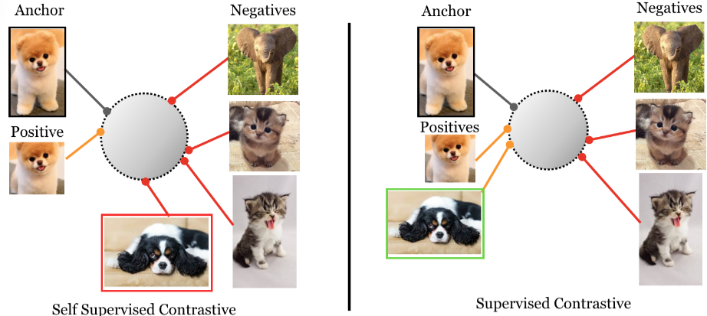
Model Implementation and Training
Supervised Contrastive Learning
Unlike traditional classification models, contrastive learning helps the system understand the nuanced boundary between natural emotional expression and speech patterns that may indicate psychological distress (Khosla, et. al, 2020)
Notes:
For our model itself, we will train it using a technique call supervised contrastive learning. Unlike traditional classification models, contrastive learning helps the system understand the nuanced boundary between natural emotional expression and speech patterns that may indicate psychological distress.

Slide 13
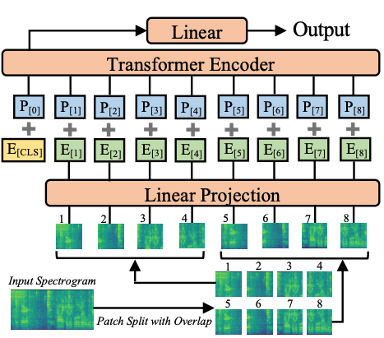
Model Implementation and Training
Pretrained Audio Model
In order to achieve better convergence and make our model more generalizable, we will use a pre-trained speech processing model, which is Audio Spectrogram Transformer (https://huggingface.co/docs/transformers/model_doc/audio-spectrogram-transformer). We will then implement the classification head for our downstream task of predicting depression severity
Notes:
In order to achieve better convergence and make our model more generalizable, we will utilized a pre-trained speech processing model, which is Audio Spectrogram Transformer, as the backbone to our model. This pre-trained model has been trained with millions of hours of audio recordings and has shown great results in audio classification tasks. We will then implement the classification head for our downstream task of predicting depression severity and train the whole model end-to-end.

Slide 14

Model Implementation and Training
Training Techniques
Early stopping
Held-Out Test set
K-Fold Cross Validation
Notes:
To ensure that our model achieve generalizability and have the best performance, we will utilize machine learning technique such as early stopping to stop the model from overfitting, held-out test set to ensure no test data for final evaluation are in the training data, and k-fold cross validation to tune the hyperparameters of our model.

Slide 15
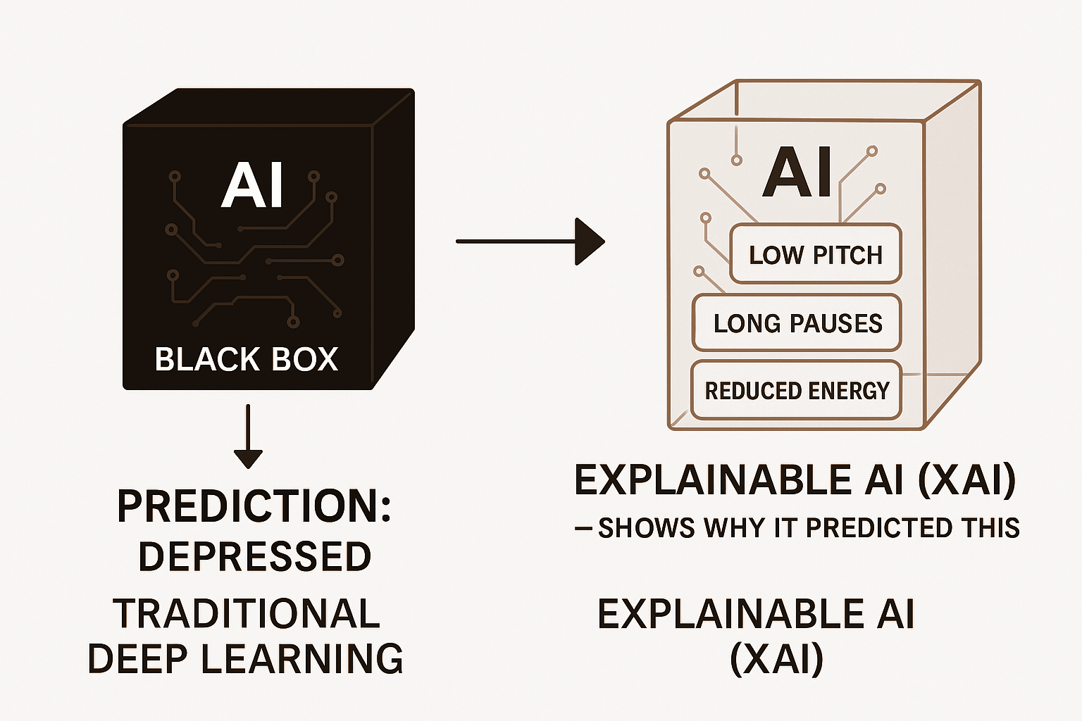
Explainable Ai
Core Idea
🔹Artificial Intelligence (AI) models often act as “black boxes.”
They make accurate predictions, but we don’t know how or why.
🔹Explainable AI (XAI) aims to make these models transparent,
showing which features or patterns drive the model’s decisions.
🔹In mental-health AI, explainability = trust + accountability
🔹XAI bridges the gap between AI prediction and human understanding, helping clinicians verify and interpret model outputs.

Slide 16
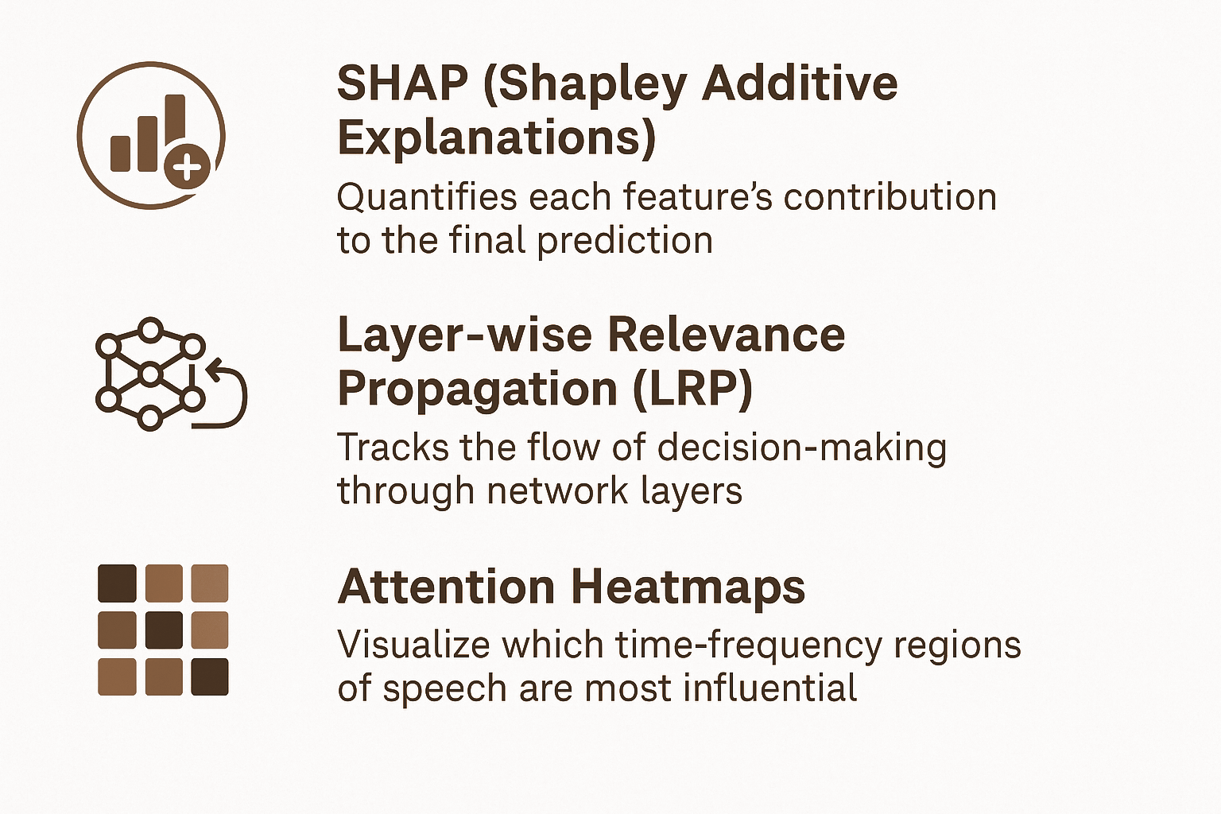
XAi Methodology
We focus on three complementary XAI techniques
🔹 SHAP (Shapley Additive Explanations)
SHAP provides per-sample explanations, allowing us to identify which specific acoustic cues indicate a higher or lower depression score.
🔹 Layer-wise Relevance Propagation (LRP)
This method reveals how information flows from raw audio features to final classification, showing the relevance assigned to each neuron or layer. It helps confirm that the model bases its conclusions on meaningful acoustic information rather than irrelevant noise.
🔹 Attention Heatmaps
These heatmaps act as a diagnostic view, showing which moments in the voice signal the model paid attention to when identifying depressive symptoms.

Slide 17
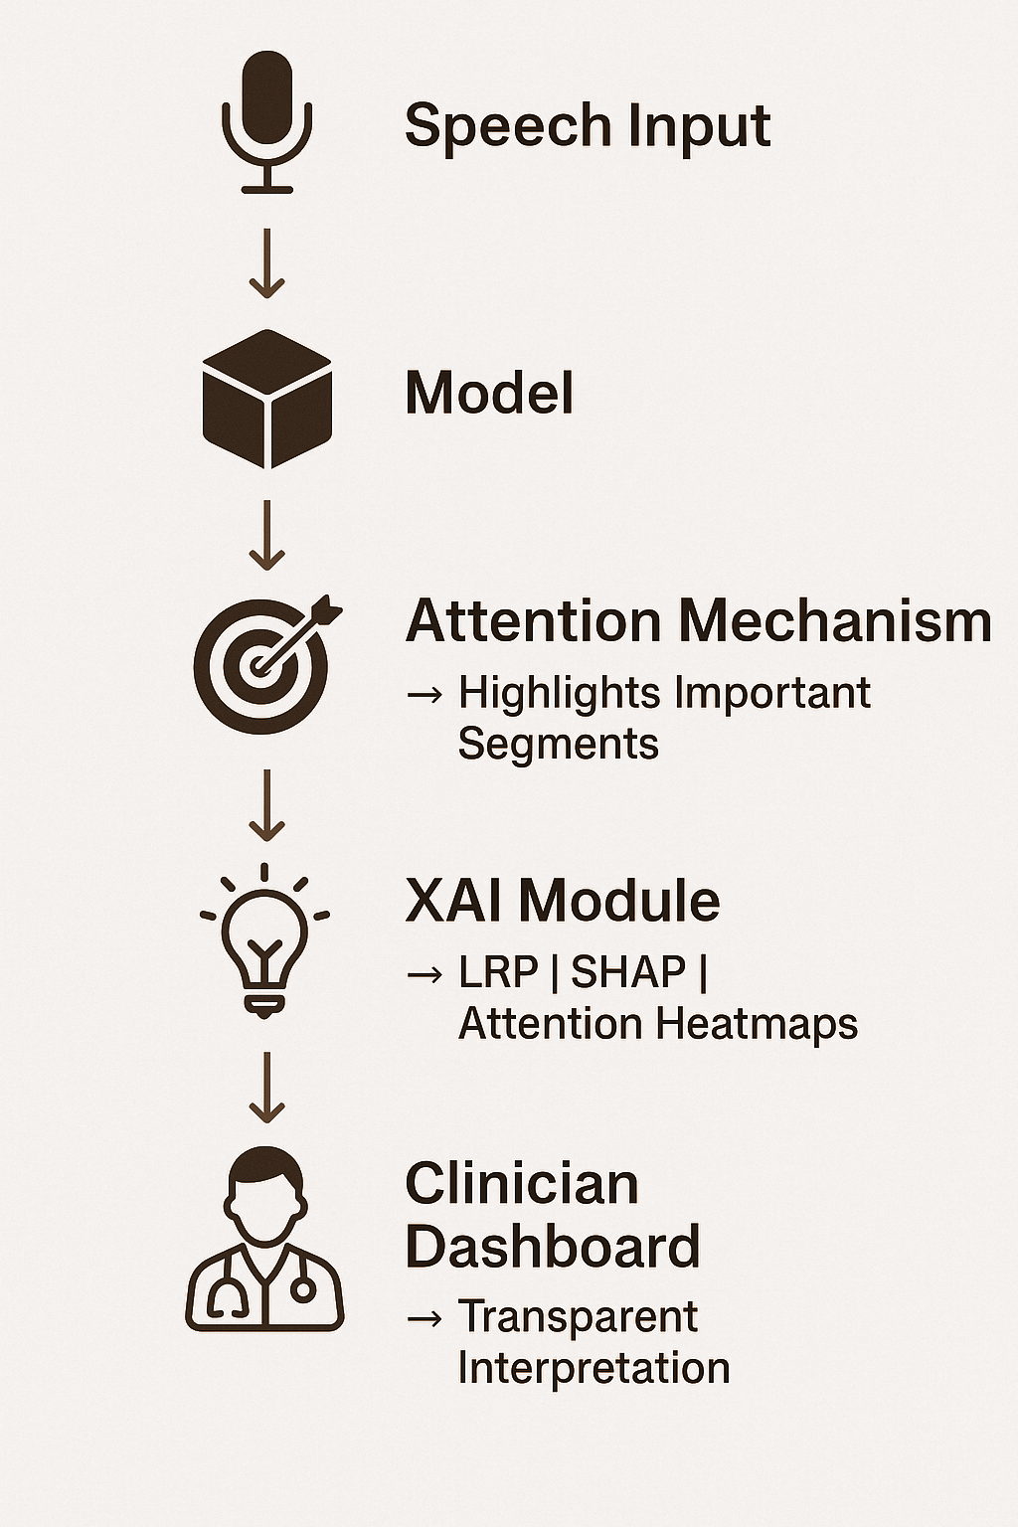
How XAi Works in Our System
Implementation Idea
🔹Our system analyzes speech prosody — tone, pitch, rhythm, and energy — using a Contrastive Deep Learning architecture.
🔹It combines Audio Spectrogram Transformer (encoder) → Model → Attention Layers → XAI Module.
🔹The XAI Module (Layer-wise Relevance Propagation, SHAP, and Attention Heatmaps) explains which acoustic cues influenced each prediction.
🔹Output: an interpretable visualization linking model attention to measurable vocal patterns.
🔹Clinicians can see why the model flagged a case as high risk — “longer pauses” or “reduced energy in speech.”

Slide 18
04
Expected Results and Application

Slide 19
Expected Results: Evaluation Metrics
Classification performance
Regression performance (severity estimation)
Improvement over traditional models
🔹Accuracy ≈ 85–88 %
🔹Recall > 0.80
🔹RMSE ≈ 4.8
🔹MAE ≈ 3.8
🔹+10–15 % higher accuracy
🔹+0.15 – 0.20 recall improvement
Validation strategy:
K-Fold Cross-Validation (K = 5) applied to evaluate model
generalization and stability across all subjects and recording conditions.
Qualitative outcome
Clear, interpretable maps linking prosodic cues → psychological states.

Slide 20
Directions of Application
Clinical integration
Telehealth screening
As a decision-support tool for psychiatrists and therapists.
Passive monitoring through mobile or online consultations.
Research extension
Public health impact
Cross-lingual transfer learning to adapt to non-English data.
Early detection, continuous monitoring, and data-driven intervention planning.

Slide 21
Conclusion
🔹We propose a novel Explainable Deep Learning framework that uses speech prosody as a non-invasive biomarker for detecting and assessing depression severity.
🔹By combining contrastive learning, hierarchical attention, and XAI visualization, our approach aims to uncover how vocal dynamics reflect underlying psychological states.
🔹The system focuses not only on performance but also on interpretability, ensuring that AI-driven assessments remain clinically meaningful and ethically transparent.
🔹Through explainable prosodic patterns—such as pitch instability, energy loss, and rhythm irregularity—clinicians can gain deeper insights into the neuropsychological aspects of mood disorders.
🔹This research lays the foundation for future AI-assisted psychiatric evaluation, supporting early detection, continuous monitoring, and trustworthy human–AI collaboration in mental healthcare.

Slide 22
Thank you
TEAM
Sakinah Hilya
UST
Khairul Makirin
KAIST
Rafsan Jany
UST
2025 Future Scholars’ Creative & Interdisciplinary Research Idea Challenge

